Slide 1



Data Science Job Posting Analysis
View in Power BI
Last data refresh:
29/04/2025 02:03:28 UTC
Downloaded at:
29/04/2025 02:05:13 UTC

Slide 2
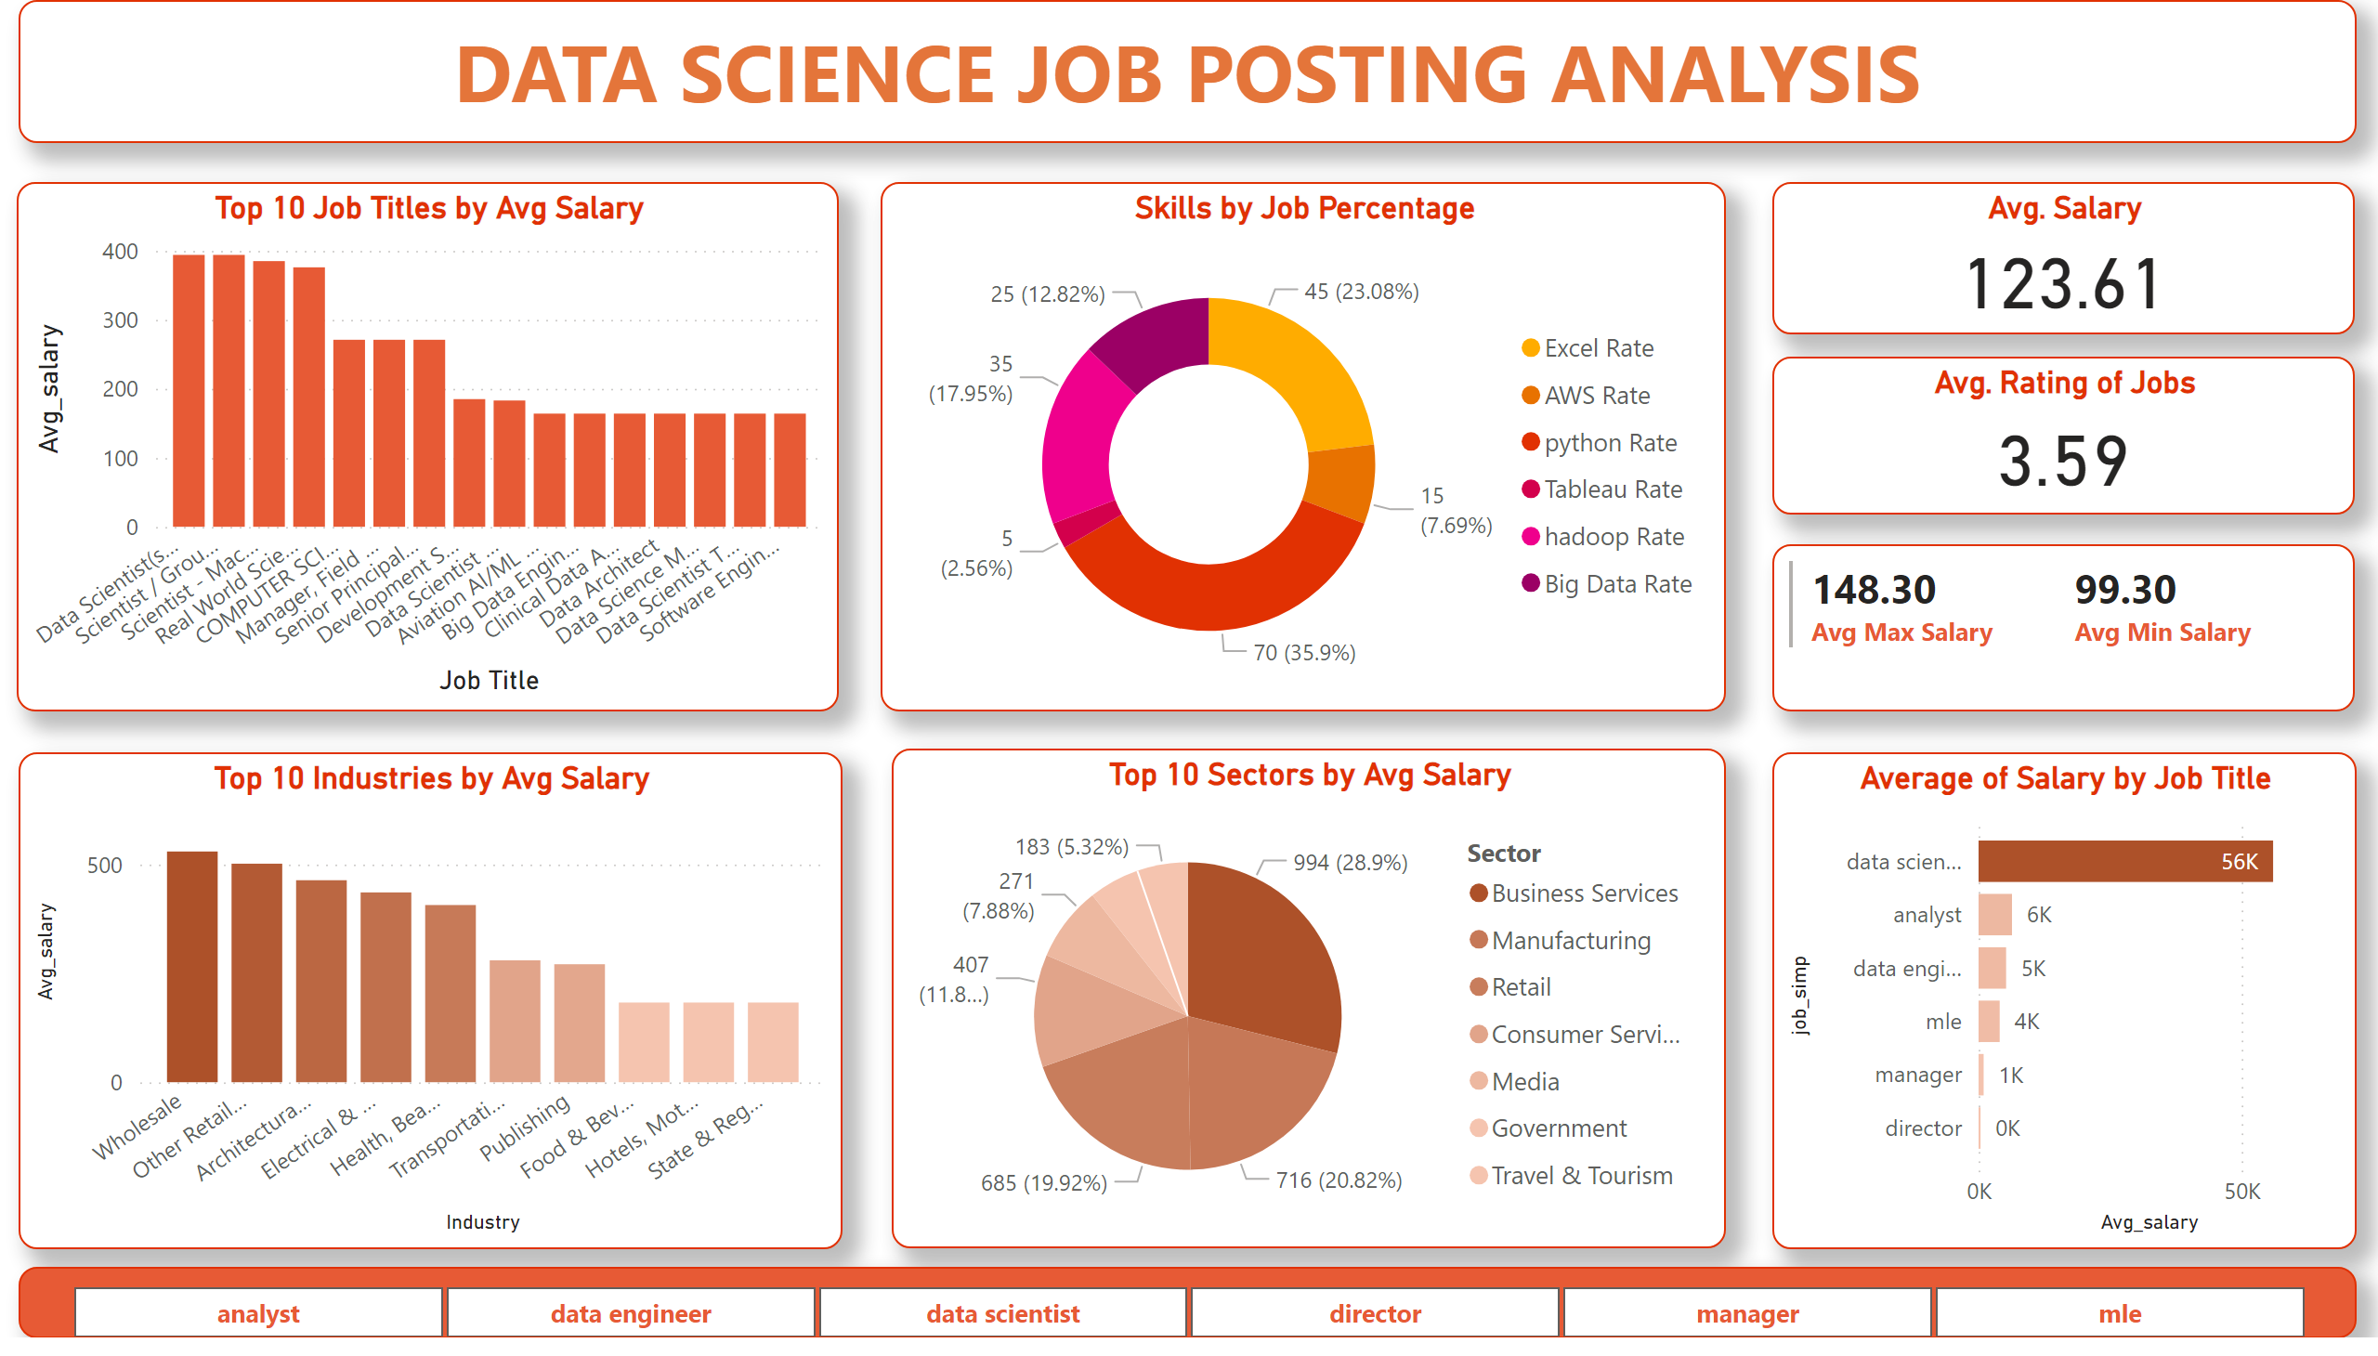
Page 1
Notes:
textbox
No alt text provided
Top 10 Job Titles by Avg Salary
No alt text provided
Skills by Job Percentage
No alt text provided
Avg. Salary
No alt text provided
Avg. Rating of Jobs
No alt text provided
Avg. Minimum Salary
No alt text provided
Top 10 Industries by Avg Salary
No alt text provided
Top 10 Sectors by Avg Salary
No alt text provided
Average of Salary by Job Title
No alt text provided
slicer
No alt text provided

